Slide 1



Key Takeaways & Thoughts
The key takeaways is the influence the AR(1) and AR(2) has on AR(p) models. It is interesting to see how the characteristics of one affects the other and most importantly how one if stronger than another. At first, I was having a hard time grasping the concept behind the factoring. Fortunately, the factor table saved my life and made it so much easier for me. One aspect I feel I may have missed out on is the real-world application of this concept or the actual value of it given true scenarios.
Javier Saldana
For Live Session: Unit 4

Slide 2

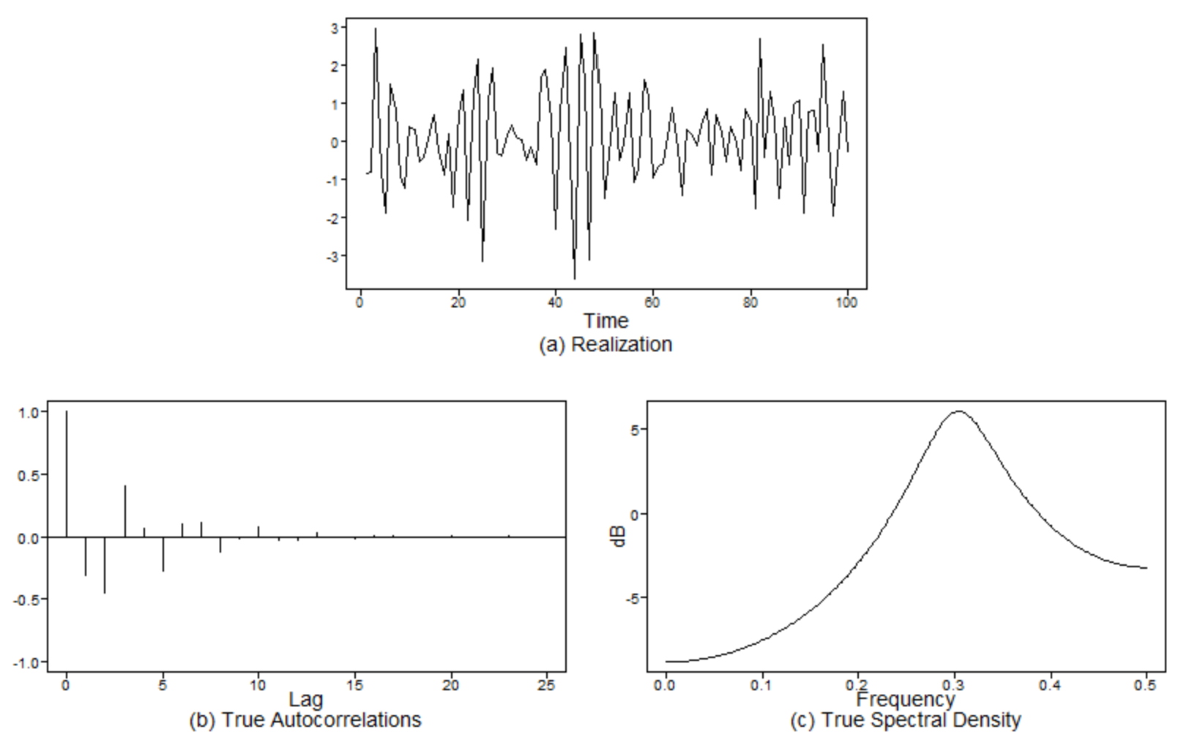
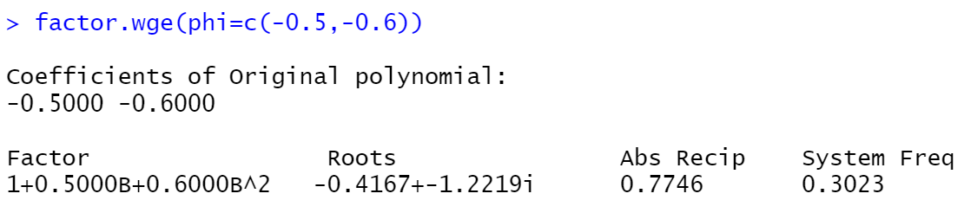
Char. Eq., Roots, & System Freq.
ACF & Spectral Density

